Slide 1


Slide 2

The Clapper
Workshop 4 – Final Touches

Slide 3
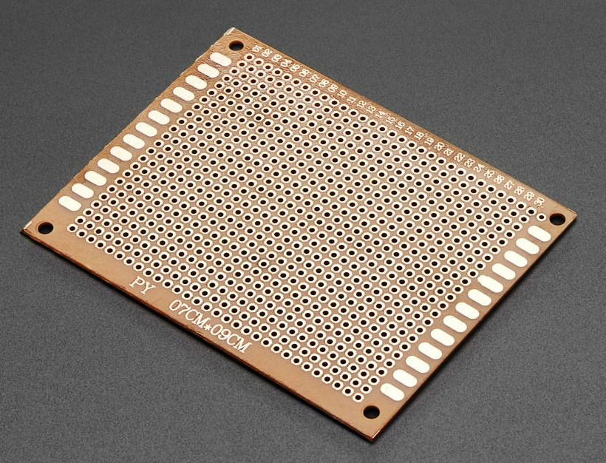
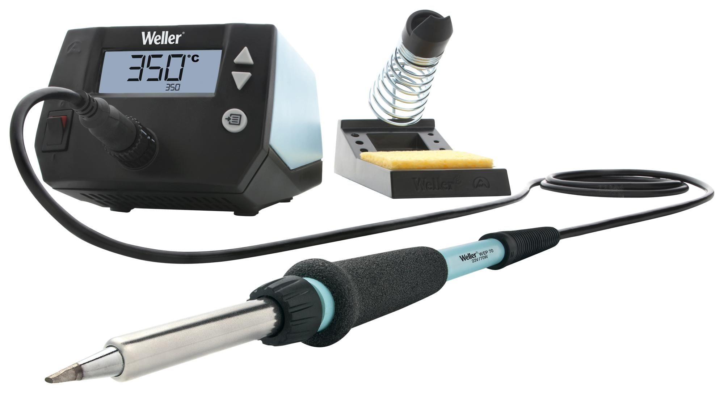
Soldering
We need to solder everything onto circuit board if you want to take your project home.
Everyone take a piece of stripboard and try to map your clapper across.
Use soldering stations in S901, S905C, and S920.
Solder the ATTiny85 on headers so you can easily remove it when you want to reprogram it.

Slide 4
Final Note
If you finish up today, we just need to get your breadboard back, you can keep the rest!
If you don’t finish, we will have a catch-up session next week.
I have placed all of the clapper workshop slides on GitHub, check them out if you need a refresher or catchup.
https://github.com/SaskiaBush/EESS-Clap-Activated-Light
There’s also an LTSpice model of the circuit there too for those who are keen to explore circuit simulation in LTSpice.
In Week 10 we will showcase all our finished projects, please bring them along!

